Slide 1

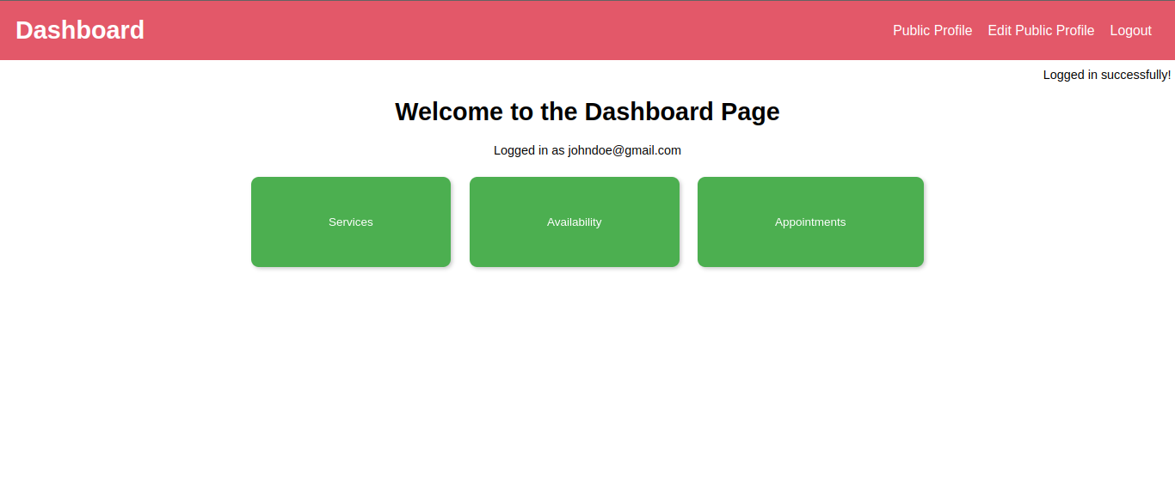

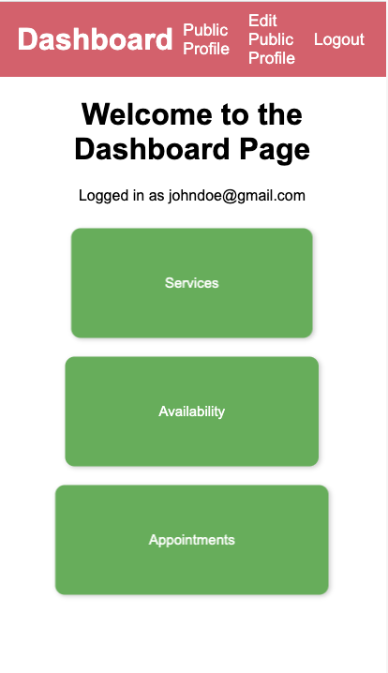
Topmate Clone
Client -Manik Taneja
Team-
Dalton Avery
Ashutosh Punyani
Braeden Smith
Geetesh Challur
Zepu Ma
Sudhanva Rajesh

Slide 2
Outline
Problem Statement
Solution Proposal
Application Overview
Testing Approaches
Challenges
Lessons Learned
Conclusion

Slide 3
Problem Statement
The objective is to create software similar to Topmate that revolutionizes the client's ability to connect with their audience and provides one-on-one interactions with his audience.
The main challenge faced by the client is that he should be able to provide his available schedules, and the audience should be able to book appointments based on the current availability.

Slide 4
Solution Proposal
Only the client would have a dashboard to provide his schedules, add/edit services provided by him, update his public profile, which is visible to all his customers, and see all the appointments booked by the customer.
Customers will be able to book their appointments for consultation through the client’s public profile section. Services offered by the client will be visible in the public profile.
When the client is adding his availability, he has to select the day and timing when he is available to provide his schedules.
Customers can fill details asked on the appointment form to book an appointment with the client.
Customers can also edit their appointment timings to another available time after they book the appointment through the edit appointment link received in the email after booking the appointment.

Slide 5
Application Overview
Individual Persona Functionality
Admin (Client)
Can add or edit the services offered by him. Can add or edit the availability for appointments. Can see all the appointments being done. Can edit his personal information and public page.
Customer (Audience)
Can see the public page and services offered by him Can create an appointment for the services offered by him Can edit the change the appointment timing to another time offered by the client and update his basic information

Slide 6
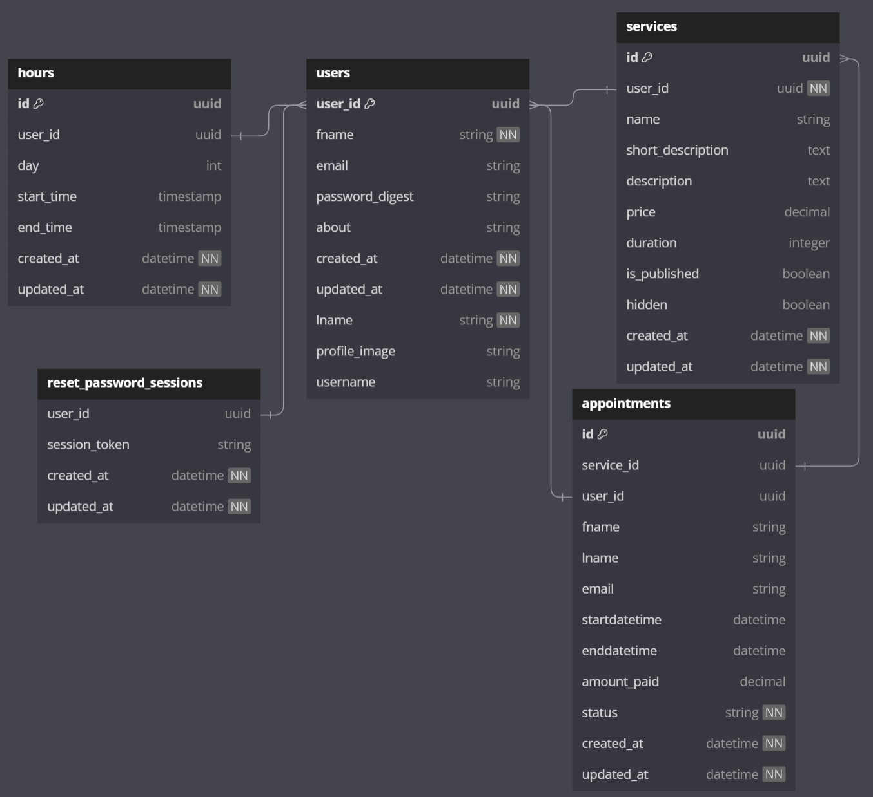
Database Entity Relationship Diagram

Slide 7
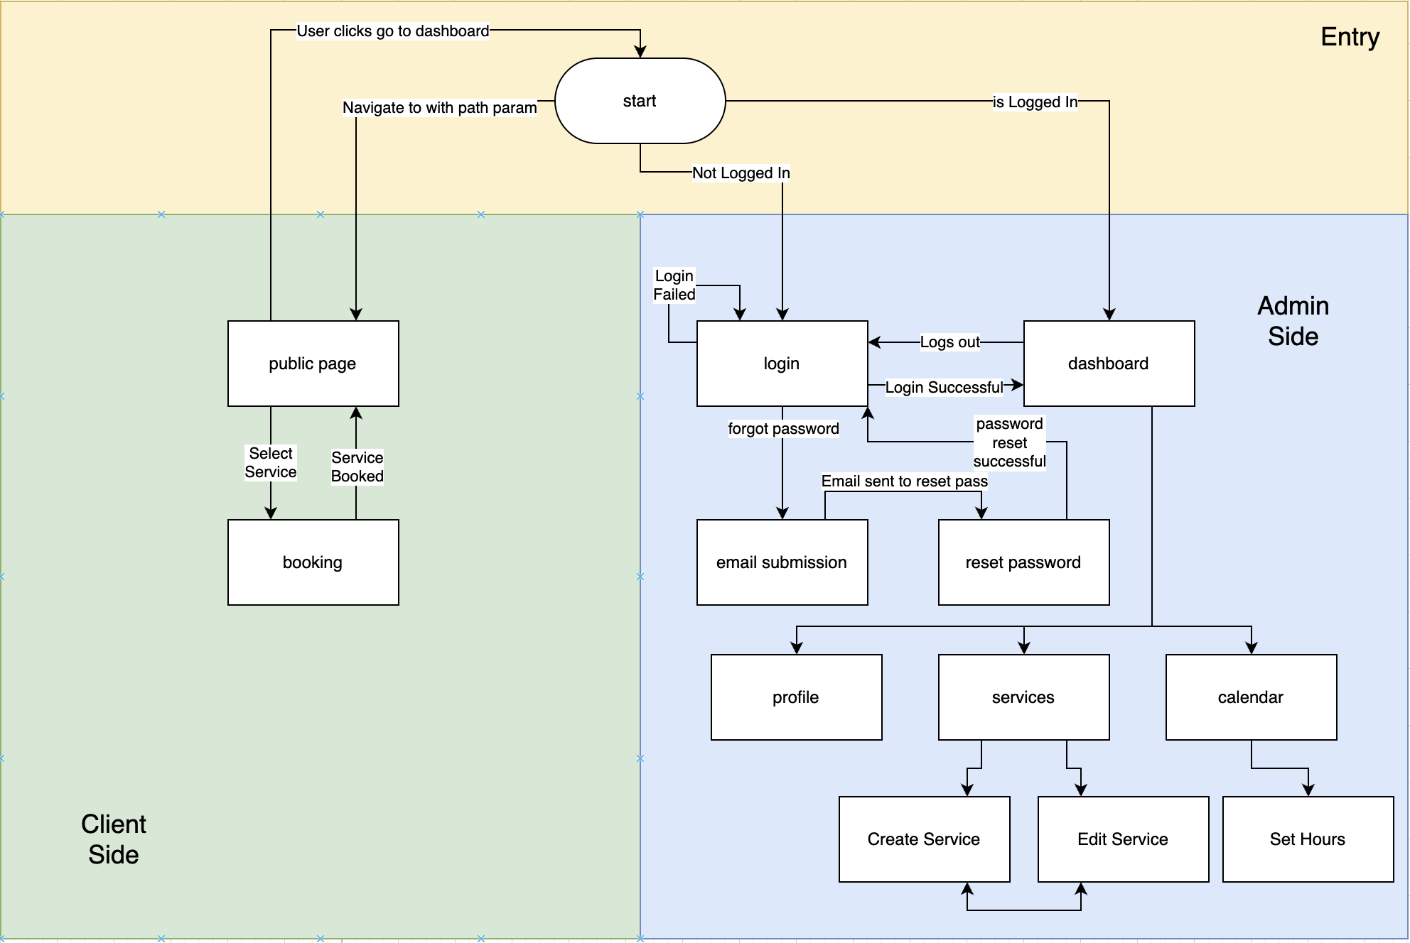
Workflow diagram

Slide 8
Testing Approaches
BDD Coverage (Cucumber testing)
Appointment (creation for invalid cases and editing the data afterward)
Service (Delete, Update, Add)
Public Page (Edit and navigation to it for various cases)
Client Available Hours
User Login, Reset Password

Slide 9
Testing Approaches
TDD Coverage (Rspec testing)
Test case for data models and their validation.
Test cases for the APIs added in the controller file to check if they are giving the correct response in various different situations.

Slide 10
Challenges
Since our project is primarily based on time, our major issue is to handle timezone problems. This will enable the client to add their availability based on their timezone, and the customer should see the client's timings adjusted to their timezone.
For a specific day, once the customer provides their availability, it has to be updated. Once a customer has booked a consultation on that day, the next customer should be able to see the updated client's availability. This ensures that there are no two customers booked for their appointment on the same day and at the same time.
After a customer has booked the appointment, they should be able to edit their information, such as name, email address, and appointment time, to match the next client's availability.

Slide 11
Lessons Learned
Throughout the project, we gained knowledge in working with Ruby on Rails, deploying code to Heroku, and setting up a Postgres Database.
Version control system was used to collaborate on a project. Merging code changes by the team can be difficult if the changes are not merged on a timely basis.
Team communication is crucial; some tasks were duplicated due to insufficient collaboration.
Learned proficiency in effectively prioritizing project user stories, ensuring a streamlined workflow. Additionally, developed adept workload management skills to enhance overall project efficiency.
This project granted us practical exposure to agile software development, imparting skills in effectively communicating with clients. We learned the process of converting client user stories into features, followed by writing tests and code to bring these features to life.

Slide 12
Conclusion
Our team developed a web application that helps customers set up appointments with our client for various services offered by him, based on when the client is available. Customers can reschedule the appointment if needed using the Ruby on Rails framework, HTML, CSS, and JavaScript. The application is designed to meet the requirements of the client.

Slide 13
Thank You!!

